Slide 1
Learning Objective
I will be able to calculate probabilities of normal distributions
Success Criteria
At the end of the lesson, I will be able to:
4.2.5 identify contexts, such as naturally occurring variation, that are suitable for modelling by normal random variables
4.2.6 identify features of the graph of the probability density function of the normal distribution with mean μ and standard deviation σ and the use of the standard normal distribution
4.2.7 calculate probabilities and quantiles associated with a given normal distribution using technology, and use these to solve practical problems

Slide 2
REVIEW: 2018 WACE (Calc-Free)
For a set of data values that are normally distributed, approximately 68% of the values will lie within one standard deviation of the mean, approximately 95% of the values will lie within two standard deviations of the mean and approximately 99.7% of the values will lie within three standard deviations of the mean.
If the heights of a large group of women are normally distributed with a mean µ = 163 cm and standard deviation σ = 7 cm, use the above information to answer the following questions:
A statistician says that almost all of the women have heights in the range 142 cm to 184 cm. Comment on her statement. (2 MARKS)
Approximately what percentage of women in the group has a height greater than 170cm? (2 MARKS)
Approximately 2.5% of the women are shorter than what height? (2 MARKS)

Slide 3
REVIEW: 2018 WACE (Calc-Free)
For a set of data values that are normally distributed, approximately 68% of the values will lie within one standard deviation of the mean, approximately 95% of the values will lie within two standard deviations of the mean and approximately 99.7% of the values will lie within three standard deviations of the mean.
If the heights of a large group of women are normally distributed with a mean µ = 163 cm and standard deviation σ = 7 cm, use the above information to answer the following questions:
A statistician says that almost all of the women have heights in the range 142 cm to 184 cm. Comment on her statement. (2 MARKS)
The range of 142 cm to 184 cm is 3 standard deviations from the mean of 163 cm.
This means that 99.7% of women have heights within this range, which also means that the statistician’s comment is appropriate.

Slide 4
REVIEW: 2018 WACE (Calc-Free)
For a set of data values that are normally distributed, approximately 68% of the values will lie within one standard deviation of the mean, approximately 95% of the values will lie within two standard deviations of the mean and approximately 99.7% of the values will lie within three standard deviations of the mean.
If the heights of a large group of women are normally distributed with a mean µ = 163 cm and standard deviation σ = 7 cm, use the above information to answer the following questions:
Approximately what percentage of women in the group has a height greater than 170cm? (2 MARKS)
170 – 163 = 7 cm (1 standard deviation above the mean)
By symmetry: 100 – (50 + 34) = 16%
16% of women will have a height greater than 170 cm.

Slide 5
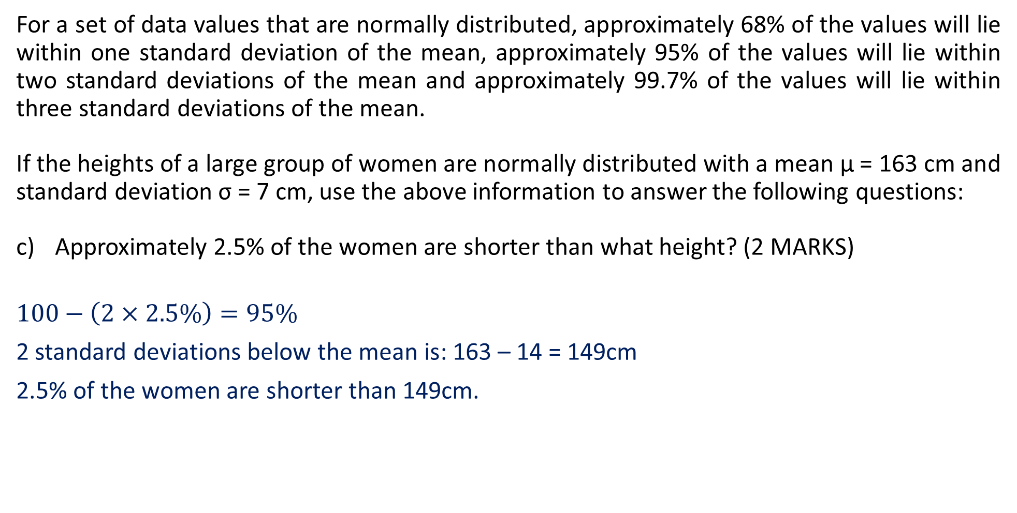
REVIEW: 2018 WACE (Calc-Free)
For a set of data values that are normally distributed, approximately 68% of the values will lie within one standard deviation of the mean, approximately 95% of the values will lie within two standard deviations of the mean and approximately 99.7% of the values will lie within three standard deviations of the mean.
If the heights of a large group of women are normally distributed with a mean µ = 163 cm and standard deviation σ = 7 cm, use the above information to answer the following questions:
Approximately 2.5% of the women are shorter than what height? (2 MARKS)
$$100−\left(2×2.5\%\right)=95\%$$
2 standard deviations below the mean is: 163 – 14 = 149cm
2.5% of the women are shorter than 149cm.

Slide 6
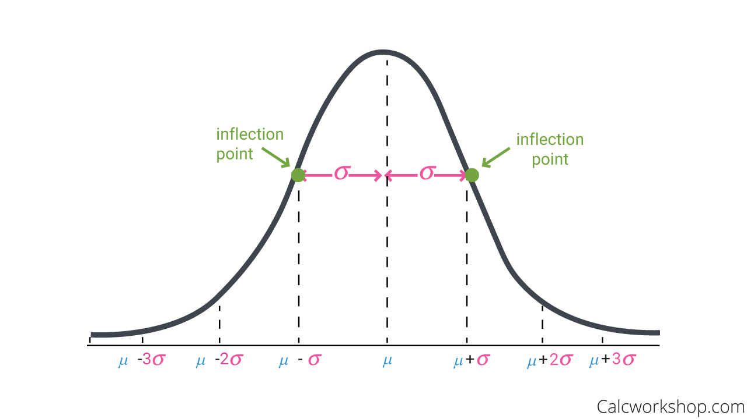
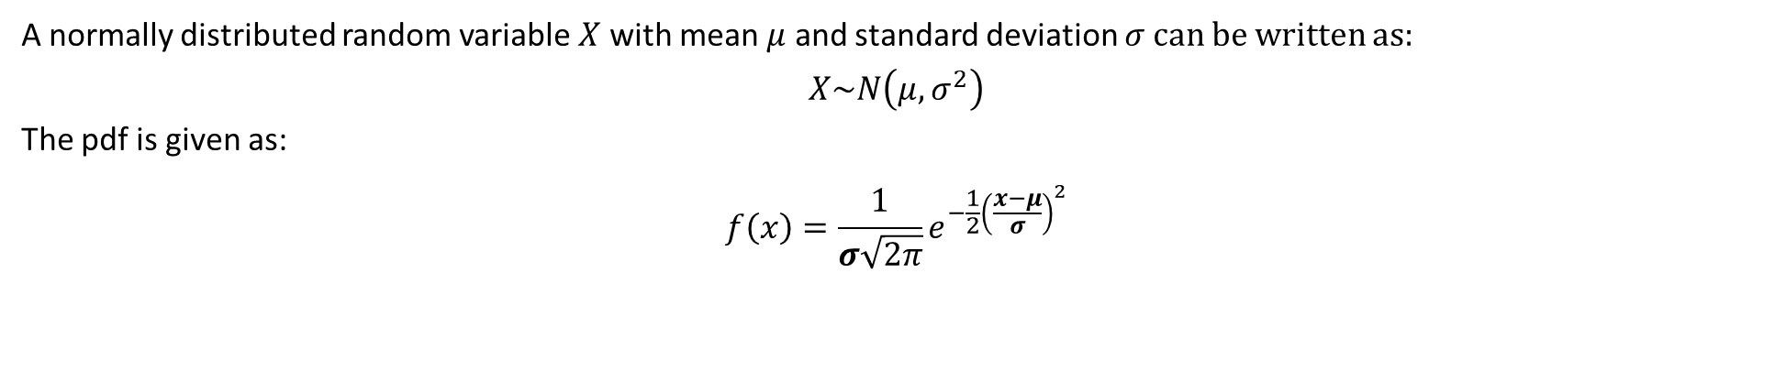
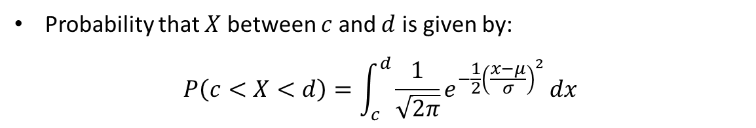
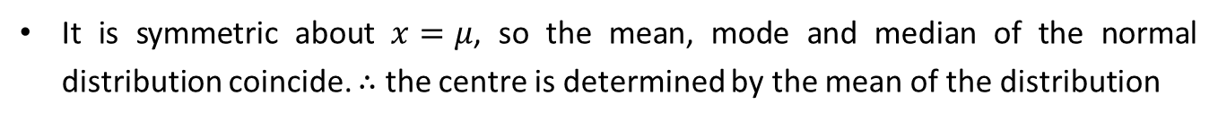
Recap: The General Normal Distribution
A normally distributed random variable $X$ with mean $μ$ and standard deviation $σ$can be written as:
$$X\sim N\left(μ, σ^{2}\right)$$
The pdf is given as:
$$f\left(x\right)=\frac{1}{σ\sqrt{2π}}e^{−\frac{1}{2}{\left(\frac{x−μ}{σ}\right)}^{2}}$$
Properties of a Normal Distribution
The graph of a normal distribution is symmetric and bell-shaped
It has an asymptote of $y=0$
It is symmetric about $x=μ$, so the mean, mode and median of the normal distribution coincide. $∴$ the centre is determined by the mean of the distribution
The width is determined by the standard deviation. The points of inflection of the curve are located one SD on either side of the mean.
The larger the value of the SD, the greater the spread of the curve.
Total area under the curve is unity, that is 1.
Probability that $X$ between $c$ and $d$ is given by:
$$P\left(c<X<d\right)=\int_{c}^{d}{\frac{1}{\sqrt{2π}}e^{−\frac{1}{2}{\left(\frac{x−μ}{σ}\right)}^{2}}}dx$$

Slide 7
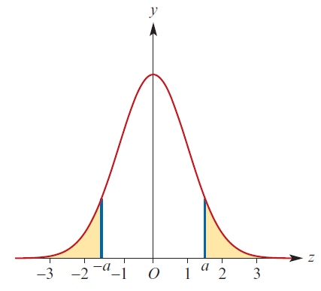
Symmetry Properties
The graph of a normal distribution is symmetric and bell-shaped. Therefore, the following properties apply:
$P\left(Z>a\right)=1−P(Z≤a)$
$P\left(Z<−a\right)=P(Z>a)$
$P\left(−a<Z<a\right)=P\left(Z<a\right)−P(Z≤−a)$
$$=1−P\left(Z≥a\right)−P(Z≥a)$$
$$=1−2P\left(Z≥a\right)$$
$$=1−2P\left(Z≤−a\right)$$

Slide 8
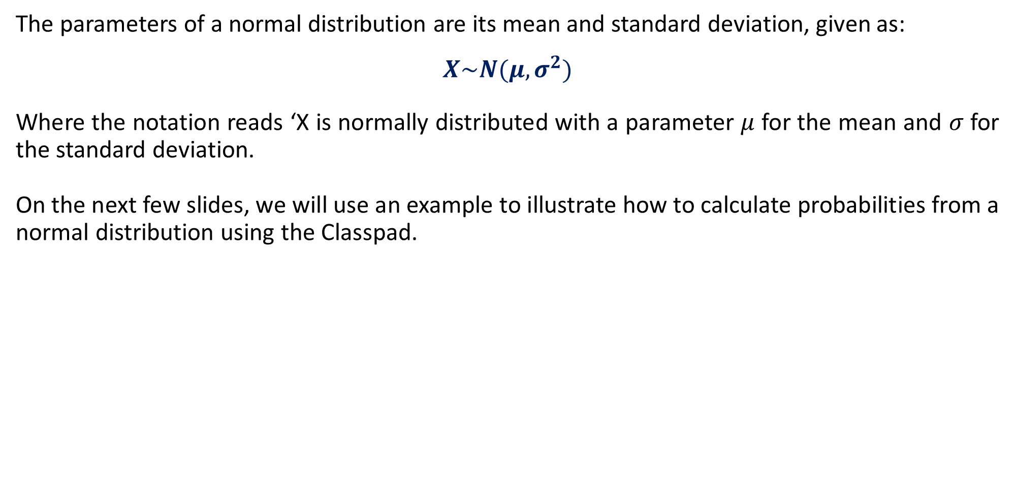
Using the Classpad for Probabilities in the Normal Distribution
The parameters of a normal distribution are its mean and standard deviation, given as:
$$X\sim N(μ,σ^{2})$$
Where the notation reads ‘X is normally distributed with a parameter $μ$ for the mean and $σ$ for the standard deviation.
On the next few slides, we will use an example to illustrate how to calculate probabilities from a normal distribution using the Classpad.

Slide 9
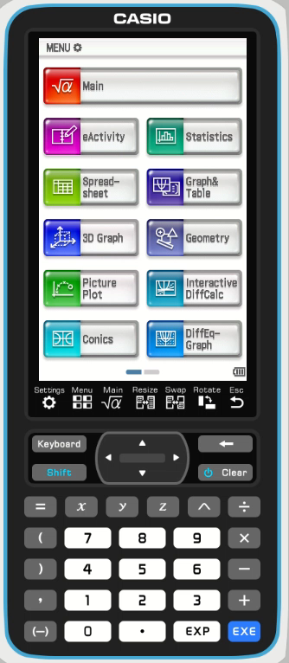
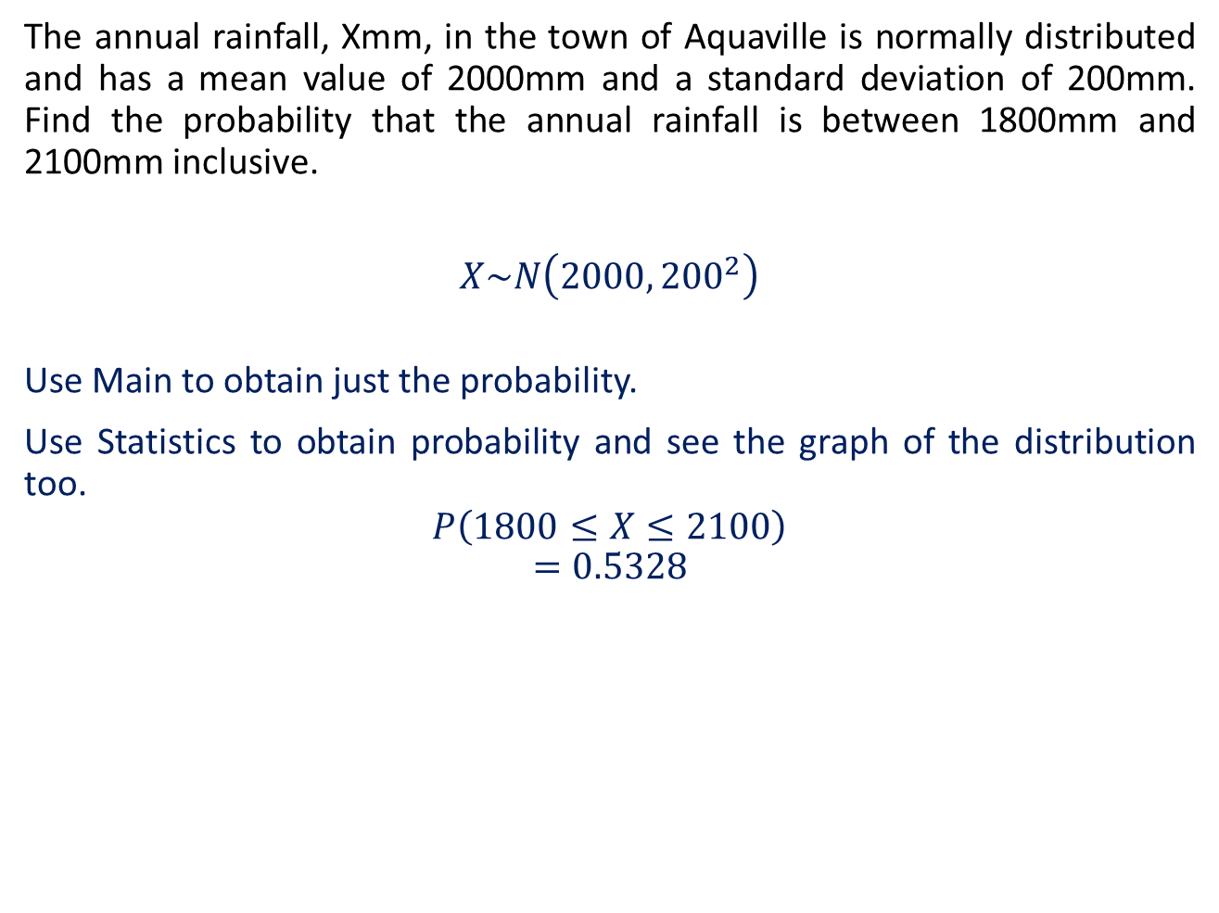
Guided Practice
The annual rainfall, Xmm, in the town of Aquaville is normally distributed and has a mean value of 2000mm and a standard deviation of 200mm. Find the probability that the annual rainfall is between 1800mm and 2100mm inclusive.
$$X\sim N\left(2000, {200}^{2}\right)$$
Use Main to obtain just the probability.
Use Statistics to obtain probability and see the graph of the distribution too.
$$P\left(1800≤X≤2100\right)$$
$$=0.5328$$

Slide 10
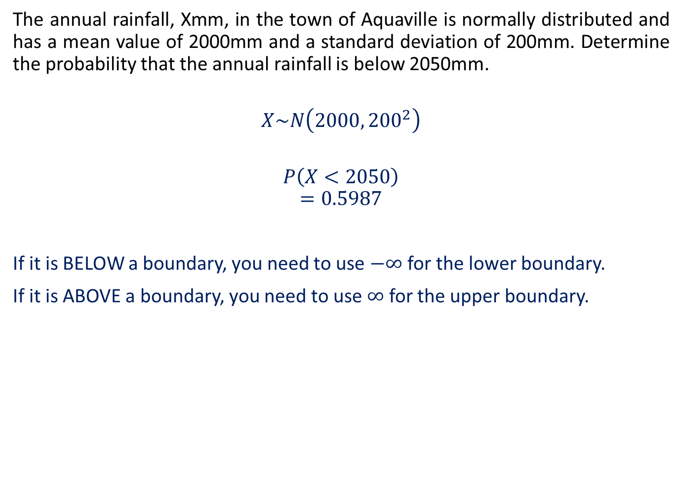
Guided Practice
The annual rainfall, Xmm, in the town of Aquaville is normally distributed and has a mean value of 2000mm and a standard deviation of 200mm. Determine the probability that the annual rainfall is below 2050mm.
$$X\sim N\left(2000, {200}^{2}\right)$$
$$P\left(X<2050\right)$$
$$=0.5987$$
If it is BELOW a boundary, you need to use $−∞$ for the lower boundary.
If it is ABOVE a boundary, you need to use $∞$ for the upper boundary.

Slide 11
Independent Practice
Complete Cambridge Ex 11C & 11D

